Slide 1
Immigration and the Impact on Students and Families
Lizzy Bowen, LMSW
August 5th, 2019

Slide 2
Agenda
why migrants are leaving and where they are coming from
The migration journey
Immigrant family experiences
Policy impacts
What we can do to help
Resources

Slide 3
Video
The Guardian- Why Central Americans are seeking refuge in the US

Slide 4
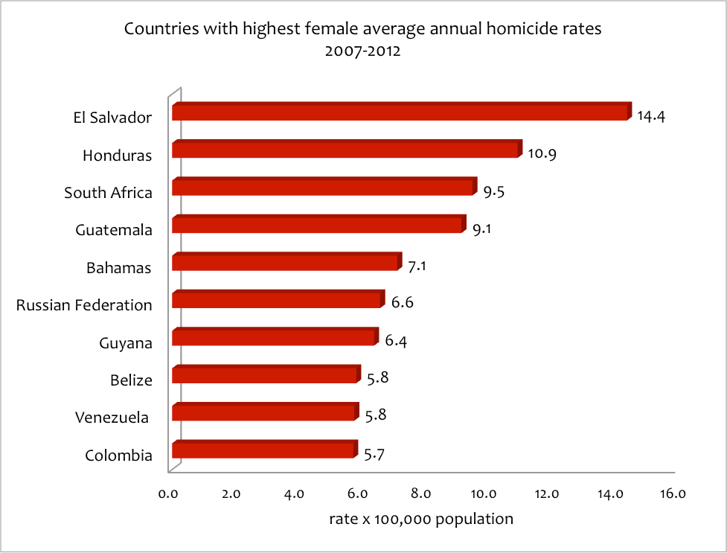
Why they are fleeing:
Gang violence
Domestic and sexual abuse
Extreme poverty
A faulty government infrastructure
Notes:
Nearly 200,000 Honduran citizens have been displaced due to violence, threats, and forced gang affiliation with MS-13 and Barrio 18.
Honduras has historically had one of the highest murder rates in the world.
Authorities recorded nearly 4,000 murders in El Salvador in 2017 alone, and say that most criminal activity is a result of gang violence at the hands of MS-13 and Barrio 18.
El Salvador's soaring homicide rate has forced thousands of its citizens to seek asylum in the US.
The forces driving ordinary people to leave their homes and put their lives at risk crossing deserts with smugglers to get to the US border are deeply rooted in Central America’s history of inequality and violence, in which the US has long played a defining role.
The flow of migrants trying to cross the border illegally is not all blowback from US foreign policy. Much of the poverty, injustice and murder in El Salvador, Guatemala and Honduras is homegrown, harking back to the age of Spanish conquest. Small criminal elites have long prospered at the expenseof the populations.
Experts on the region argue, however, that when politicians or activists have come forward on behalf of its dispossessed, the US has consistently intervened on the side of the powerful and wealthy to help crush them, or looked the other way when they have been slaughtered.
Law-enforcement officials estimate that one gang, MS-13, operates an extortion racket with little pressure from authorities in 248 of the 262 of the country’s municipalities. It battles for neighborhood control with another gang, Barrio 18, which runs its own protection scheme in nearly as many regions.
Latin America accounts for 8% of the world’s population and a third of its homicides, which makes it one of the world’s most murderous regions. At its violent core is El Salvador, where an imported American gang culture rivals government authority, and its leaders hold sway with a surplus of money, guns and willing young men.
In El Salvador, where there are around 65,000 thousand active gang members with a social support base of half a million people, boys from 12 years up are prime targets for recruitment. Girls can also be targeted at an early age, either to be sexually abused or to become gang members. The eventual fate of a girl—whether she is left alone, harassed into joining the gang, or forced into becoming a sex slave—depends entirely on the local leaders, or palabreros, who run the local cells or clicas (cliques) of the two largest gangs, MS-13 and Barrio 18.
The phenomenon has grown so rapidly since the 2000s that it has penetrated deep into the social fabric of Guatemala, Honduras, and El Salvador, meaning police operations alone aren’t enough to defeat the gangs. Top state officials in the region are aware of the magnitude of what they face, and behind closed doors agree that they are “fighting a war they cannot win.”
Nevertheless, the governments from El Salvador, Guatemala, and Honduras continue to rely almost solely on security crackdowns to tackle gangs. This has indirectly created yet another reason for the local population to flee. As an NGO worker in El Salvador told me recently: “The situation is so bad that sometimes people are more scared of the police than the gangs.”

Slide 5
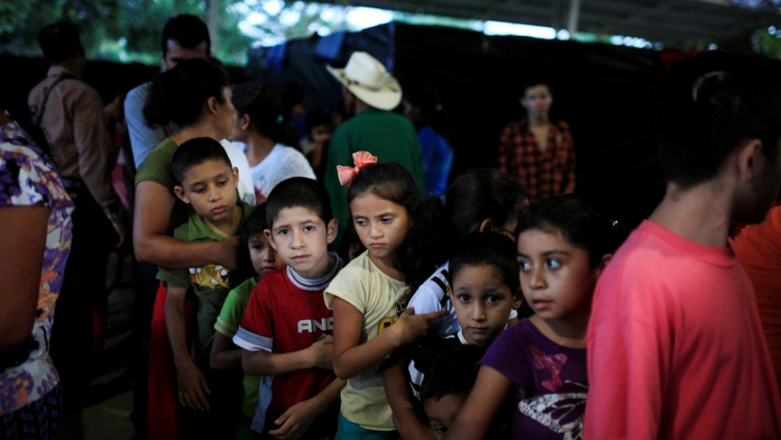
Asylum
Asylum- protection granted to foreign nationals already in the United States or at the border who meet the international law definition of a refugee
a person who is unable or unwilling to return to their home country, and cannot obtain protection in that country, due to past persecution or a well-founded fear of being persecuted in the future “on account of race, religion, nationality, membership in a particular social group, or political opinion
Notes:
Asylum applications from Central America and Mexico made up about half of all applications to the United States.
Between 2011 and 2017, asylum applications from the Northern Triangle have increased 991 percent.
Women, children, and unaccompanied minors make up a large portion of those seeking refuge from the Northern Triangle.
1.5 million children are out of school in Guatemala. School desertion often leads to confinement at home, child labour, forced or coerced recruitment, internal or cross-border displacement, among other consequences.
Asylum is a protection granted to foreign nationals already in the United States or at the border who meet the international law definition of a “refugee.” The United Nations 1951 Convention and 1967 Protocol define a refugee as a person who is unable or unwilling to return to his or her home country, and cannot obtain protection in that country, due to past persecution or a well-founded fear of being persecuted in the future “on account of race, religion, nationality, membership in a particular social group, or political opinion.” Congress incorporated this definition into U.S. immigration law in the Refugee Act of 1980.
As a signatory to the 1967 Protocol, and through U.S. immigration law, the United States has legal obligations to provide protection to those who qualify as refugees. The Refugee Act established two paths to obtain refugee status—either from abroad as a resettled refugee or in the United States as an asylum seeker.

Slide 6
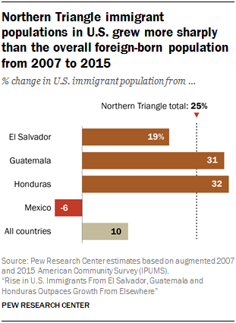
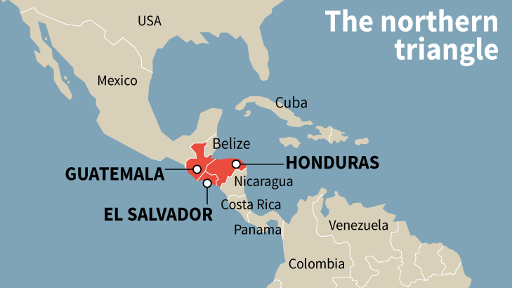
Where they are coming from:
The Northern Triangle
14th most dangerous country = Mexico
6th most dangerous country = Guatemala
4th most dangerous country = Honduras
Most dangerous country = El Salvador
Notes:
2,249% increase
Between 2011 and 2016, the number of people from the Northern Triangle who have sought refuge in surrounding countries increased by 2,249 percent.
539,500 displaced people
By the end of 2019, there are expected to be 539,500 people displaced from Central America.
49,000 Salvadorian children
drop out of school
In 2018 alone, 49,000 children and adolescents in El Salvador dropped out of school. In Guatemala and Honduras, there are over 2 million children out of school.
Gang warfare and violence have transformed parts of Central America into some of the most dangerous places on earth. In recent years, El Salvador, Honduras and Guatemala (known as the Northern Triangle) have experienced a dramatic escalation in organized crime by gangs, called maras.
Thousands of parents have fled with their families and, in many cases, children have made the perilous journey alone. These unaccompanied children are some of the world’s most vulnerable refugees – they have witnessed horrific violence and faced extreme risk
Current homicide rates are among the highest ever recorded in Central America. Several cities, including San Salvador, Tegucigalpa and San Pedro Sula, are among the 10 most dangerous in the world. The most visible evidence of violence is the high rate of brutal homicides, but other human rights abuses are on the rise, including the recruitment of children into gangs, extortion and sexual violence.

Slide 7
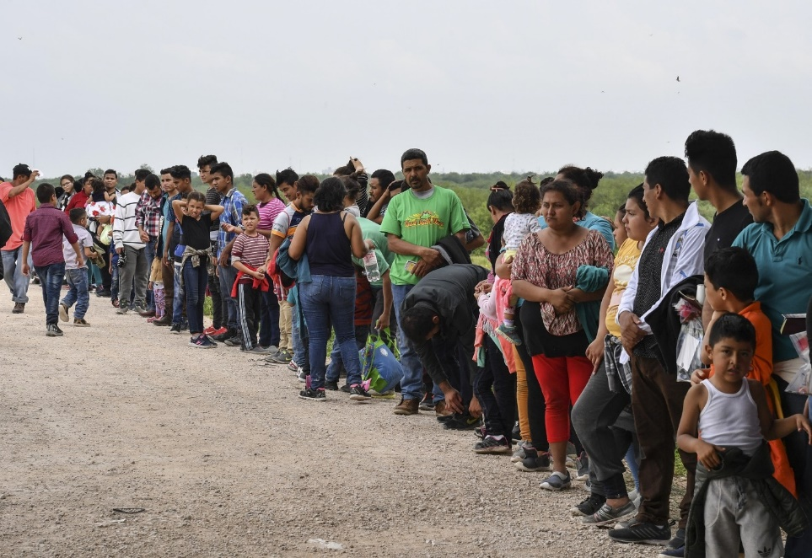
Who is coming:
More than 100,000 immigrants detained in May of 2019
Majority children and families
Notes:
The May figure amounts to a 182 percent increase over May 2018, and it is a sixfold leap from May 2017, when border arrests were near their lowest level in half a century and U.S. authorities detained fewer than 20,000.
Now an unprecedented share are Central American families and children who cannot be easily sent back. Acccording to Homeland Security figures, 98 percent of the families who were taken into custody along the border in 2017 remain present in the United States.
Children who arrive with or without a parent accounted for nearly 40 percent of CBP apprehensions in May, the latest figures show.
Today’s migrant flow is very different. Yes, there are still male heads of household seeking to pursue the “American Dream” in the U.S. so as to send home a couple of hundred dollars each month to their families. But the crux of the recent crisis at the border is that there are fewer male migrants in their 20s or 30s making the crossing, and many more families, newborns, children, and pregnant women escaping life-or-death situations as much as poverty.

Slide 8
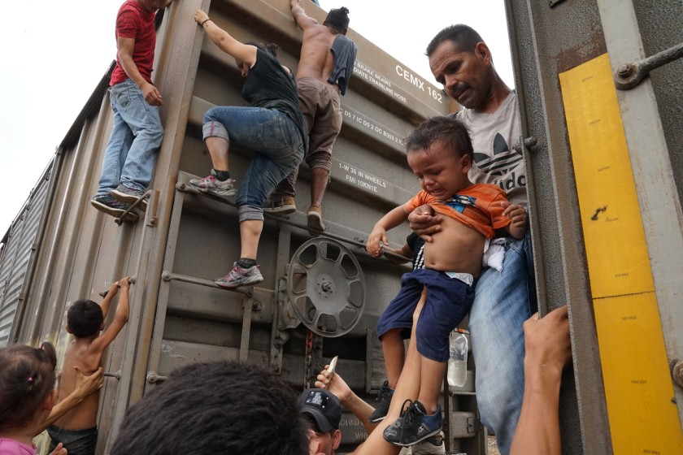
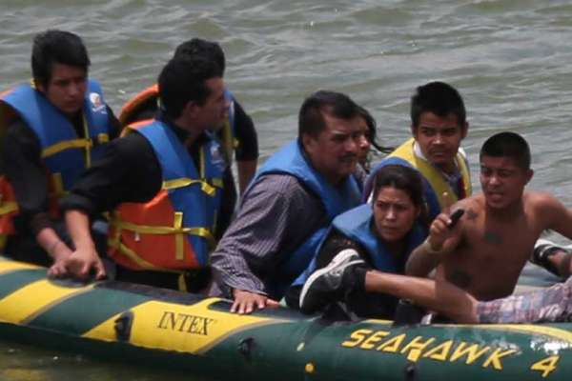
The migration journey
Issues including: assaults, robbery, kidnapping, abductions, rapes, and murder.
La bestia
Coyotes
They can pay $7,000 to $10,000 for the whole trip
Notes:
Traversing a route infamous for its danger – the Mexican leg of the journey crosses states long in thrall to the country’s powerful drug cartels – their safety in numbers logic is self-evident. What is forcing thousands of people into such a precarious flight?
In Honduras, where the caravan originated, the past decade has seen the terrorizing effects of street violence by criminal gangs exacerbated by an increased presence of Mexican cartels, police abuses and the murder of human rights and environmental activists, most notoriously that of Berta Cáceres in 2016.
Much of this current instability can be traced back to the June 2009 ouster of its then president, the erratic leftist Manuel Zelaya. Though the then US president Barack Obama declared the ouster “not legal”, his administration subsequently worked with regional powers such as Mexico to assure Zelaya did not return to office.
By the time they reach Saltillo, Coahuila’s capital, they have made a perilous journey of nearly 2,000 kilometers. Along the way, many of these men, women and children suffer assaults, robbery and abduction by criminal gangs. There are also reports of extortion and ill-treatment by police and immigration officials. Tragically, some migrants are killed before they even get this far.
As many as 20,000 migrants are kidnapped every year in situations like this. The abductions can be lucrative: they earn criminal gangs an estimated $50 million each year, according to the Mexican National Human Rights Commission.
Health professionals report that as many as six in ten migrant women and girls are raped on the journey. And activists repeatedly raise concerns that abducted women and girls are vulnerable to trafficking.
“In spite of all the hardships we left, the real nightmare is the journey through Mexico,” Jhonny concluded.
As many as half a million Central American immigrants annually hop aboard freight trains colloquially known as “La Bestia,” or the beast, on their journey to the United States. The cargo trains, which run along multiple lines, carry products north for export. As there are no passenger railcars, migrants must ride atop the moving trains, facing physical dangers that range from amputation to death if they fall or are pushed. Beyond the dangers of the trains themselves, Central American migrants are subject to extortion and violence at the hands of the gangs and organized-crime groups that control the routes north.
Drug cartels that operate along the Mexico-U.S. border are another tentacle in the migrant smuggling business.
“They are our ticket into the United States, because they are the ones who control the border,” the coyote said. In Reynosa and the surrounding state of Tamalulipas, the Gulf Cartel controls the border. Los Zetas control regions to the west.
Ramón said he pays the cartel for each client; more for adults, less for minors. The cartel's men sometimes show up before the groups cross, to count the migrants and make sure the coyotes pay the right amount.
Some migrants have complained that their coyotes abandoned them or that they were kidnapped during their trip through Mexico. Smugglers then telephone their relatives and demand even more money to continue their trip.
Many families want to be detained by U.S. authorities after they cross the border, because they want to apply for asylum. Others want to avoid detection so they can continue their trip and find a job somewhere.
Ramón added that the majority of migrants arrive at the border “so their families can survive in those countries where they have practically nothing.”

Slide 9
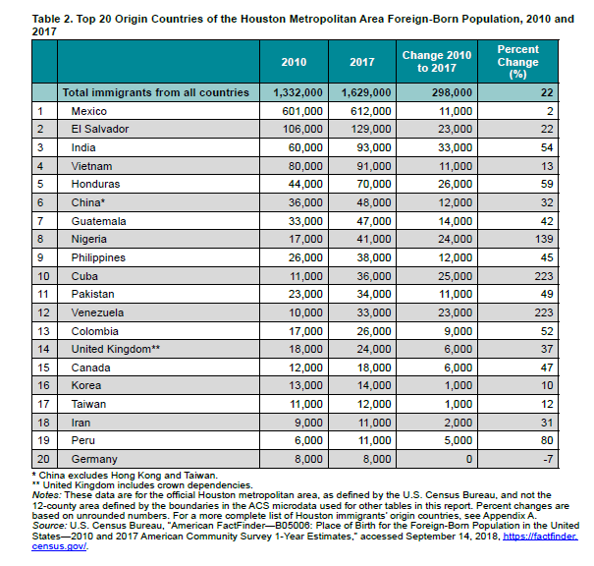
Houston
1.6 million immigrants
More Latinos than non-Hispanic white residents
1/3 of all workers in Houston
Almost ½ of the children in Houston are from immigrant families
Notes:
The highly diverse and rapidly growing Houston metropolitan area is home to 1.6 million immigrants, ranging from high-skilled professionals to working-class families and international students. In 2017, for the first time, the region was home to more Latino than non-Hispanic White residents, alongside substantial Asian and African populations. Mexico remains the top origin country for immigrants in Houston, but other foreign-born populations, including from Venezuela, Cuba, and Nigeria, have grown much more quickly in recent years.

Slide 10
Policies
All students – regardless of their immigration status – have the right to a public education
ICE Raids
SB-4 and “Sanctuary Cities”
DACA
Know Your Rights
Sensitive Locations
Notes:
Some school districts have declared themselves “sanctuary districts” to publicly state they will not give over information. However, even without a formal declaration, schools have no legal obligation to turn over information about students or their families to federal immigration officers without a warrant, subpoena, or court order, in part because of protections under the Family Educational Rights and Privacy Act (FERPA).
Legal Protections for Immigrant-Background Students
Rule No. 1. All Children Have the Right to Free, Public Education Regardless of Immigration Status
Rule No. 2. Schools Cannot Share Personal Information about Immigrant Students and Families without Their Permission
Legal Protections for English Learners
Rule No. 3. English Learners Must Have Meaningful Access to Education
Rule No. 4. States Must Hold Schools Accountable for Ensuring ELs Achieve English Proficiency and Academic Standards
Rule No. 5. Schools Must Use Data and Evidence to Make Decisions
Legal Protections for Limited English Proficient Parents and Parents of English Learners
Rule No. 6. Schools Must Communicate with Parents and Guardians in a Language They Understand
Rule No. 7. Schools Must Meaningfully Engage Parents and Guardians of ELs
– A recent nationwide survey found that 90 percent of administrators “reported observing emotional and behavioral problems among immigrant students” who fear deportation of their parents or family members or may have already experienced a family member’s deportation.
– Two-thirds of respondents also said that there was fear and concern from classmates who are not targets of enforcement who fear for their friends.
– Educators who work with immigration have experienced increases in anxiety, workload, and a diminished sense of trust in schools. Teachers now feel a responsibility to get information around immigration for their students and for themselves. School counselors, already underfunded and overworked, are facing increased workloads themselves. Additional funding to hire more counselors is one way policymakers can help mitigate the effects of the current immigration crackdowns.
This bipartisan, bicameral bill would provide Dreamers — young undocumented immigrants who were brought to the United States as children and have lived in the U.S. at least four years — protection from deportation and an opportunity to obtain legal status if they meet certain requirements.
Almost 800,000 young undocumented immigrants, who came to America as children, have lived here since at least 2007 and met other requirements, are recipients of Deferred Action for Childhood Arrivals (DACA), through which they qualified for temporary protection from deportation and legal work authorization for a renewable period of two years.
What Would the Dream Act Do?
The Dream Act would create a conditional permanent resident status valid for up to eight years for young undocumented immigrants that would protect them from deportation, allow them to work legally in the U.S. and permit them to travel outside the country.
To qualify for conditional permanent resident status, young undocumented immigrants would need to meet the following requirements:
Through documentation described in the bill, establish that they were brought to the U.S. at age 17 or younger and have lived continuously in the U.S. for at least four years prior to the bill’s enactment;
Pass a government background check, demonstrate “good moral character” with no felony or multiple misdemeanor convictions, submit biometric and biographic data and undergo a biometric and medical exam;
Demonstrate they have been admitted to a college or university, have earned a high school diploma, or are in the process of earning a high school diploma or an equivalent; and
Pay a fee.
Sensitive locations - Refers to the sites that the U.S. Immigration and Customs Enforcement (ICE) and U.S. Customs and Border Protection (CBP) have each issued and implemented policies concerning enforcement actions at or focused on ‘sensitive locations.’ Such sites include: ● Schools, such as known and licensed daycares, pre-schools and other early learning programs; primary schools; secondary schools; post-secondary schools up to and including colleges and universities; as well as scholastic or education-related activities or events, and school bus stops that are marked and/or known to the officer, during periods when school children are present at the stop; ● Medical treatment and health care facilities, such as hospitals, doctors’ offices, accredited health clinics, and emergent or urgent care facilities; ● Places of worship, such as churches, synagogues, mosques, and temples; ● Religious or civil ceremonies or observances, such as funerals and weddings; and ● During public demonstration, such as a march, rally, or parade
“Sanctuary cities” is actually a misnomer. While many Americans believe that it refers to a city that doesn’t prosecute immigrants, so-called “sanctuary cities” actually refer to something far more specific.
There’s no single definition of what is a sanctuary city, but generally speaking, it’s a city (or a county, or a state) that limits its cooperation with federal immigration enforcement agents in order to protect low-priority immigrants from deportation, while still turning over those who have committed serious crimes. This is why we prefer the term “safe cities”.
eing undocumented is not a crime. It’s a civil violation. Undocumented immigrants have rights under the U.S. Constitution. And according to due process, the police cannot detain anyone who hasn’t at least been suspected of a crime. If a police officer encounters someone walking down the street who turns out to be undocumented, they cannot arrest that person because that person has not committed a crime (ICE, however, can). Similarly, if the police arrest someone undocumented – for example, someone suspected of committing a crime, who is then cleared, they must let that person go.
Important legal point #2: holding an immigrant past the point when they should be released, just so that ICE can pick them up, is unconstitutional. Multiple courtshave said so, and immigrants can sue the police for unlawful holding.
Update (3/13/18): A federal appeals court upheld portions of Texas’ anti-immigrant SB4 law. The American Civil Liberties Union is challenging the law.
What is SB4?
SB4 is a Texas law that forces local governments and law enforcement agencies to do the work of federal immigration officers. It punishes local officials who choose to prioritize their communities’ safety over the anti-immigrant agenda of politicians, diverts precious local resources away from communities to serve the needs of the federal government, corrodes public trust in law enforcement, and drives victims and witnesses of crime into the shadows, making everyone less safe. Sheriffs and police chiefs across the state strongly advised the legislature not to pass this awful law. Governor Abbott signed SB4 on May 7, 2017.
What is the status of SB4?
Cities and counties across the state challenged SB4 in federal court arguing that it was unconstitutional. On August 30, the court issued an order temporarily blocking the majority of SB4 from going into effect. The State of Texas immediately appealed the district court's preliminary injunction order to the 5th Circuit Court of Appeals and moved for an emergency stay of the order. After a hearing on September 22, 2017, in New Orleans, the 5th Circuit Court unblocked only the detainer mandate, leaving largely in place the injunction. On November 7, 2017, the Court of Appeals held a hearing on the full merits. On March 13, 2018, the Court of Appeals issued a ruling that unblocked most of the law, effectively allowing SB4 to go into effect.
What has been changed?
Local officials can still make their own decisions about whether or when to assist in federal immigration enforcement, and will not face penalties for declining requests to assist with federal immigration agents.
Local officials are now free to speak out against laws like SB4 that would require cooperation with federal immigration enforcement. For example, sheriffs and police chiefs can continue to speak publicly about why asking about immigration status is a poor police practice that harms public safety.
What was NOT blocked?
Local officers can still ask about immigration status, if they choose to, but only during a lawful stop or arrest. But local officers cannot stop someone solely to ask about immigration status.
Local officers are not required to ask about immigration status—they can choose not to ask. Local officers will not face any penalties if they chose not to ask about immigration status.
If local officers decide to ask about immigration status, they cannot hold a person longer solely to inquire about their status or attempt to verify their status with Immigration and Customs Enforcement (ICE).
If a local officer learns that someone is undocumented, he or she cannot arrest or continue to hold the person on that basis. The officer can provide that information to ICE, but is not required to do so and can choose not to.
If questioned about your immigration status by local or state police:
You do not have to answer any questions about your immigration status, including where you were born, how you entered the U.S., if you are a citizen, or if you have lawful status or "papers."
You have the right to remain silent. Simply say clearly that you wish to remain silent and that you do not wish to answer any questions about your status.
If you are stopped in your car:
Neither the driver nor passengers need to answer questions about anyone's immigration status.
If you are the driver of the vehicle, you should provide your driver's license, proof of insurance and registration to the requesting officer, if you have them. Do not provide false documents.
If you are a passenger, you can ask if you are free to leave. If yes, silentely leave.
You do not need to provide foreign identification.
If you are under arrest:
You must give your name, residence address, and date of birth only.
You do not have to answer any other questions. Say clearly that you wish to remain silent.
Do not say anything else, sign anything, or make any decisions without a lawyer.
Have you been affected by SB4?
Call the Immigrant Rights Hotline. If you or your family have been detained, arrested, or questioned about your immigration status because of SB4, please contact the ACLU of Texas at 1-833-HOU-IMMI (1-833-468-4664), 9 a.m.-5 p.m., Mon. - Fri.

Slide 11
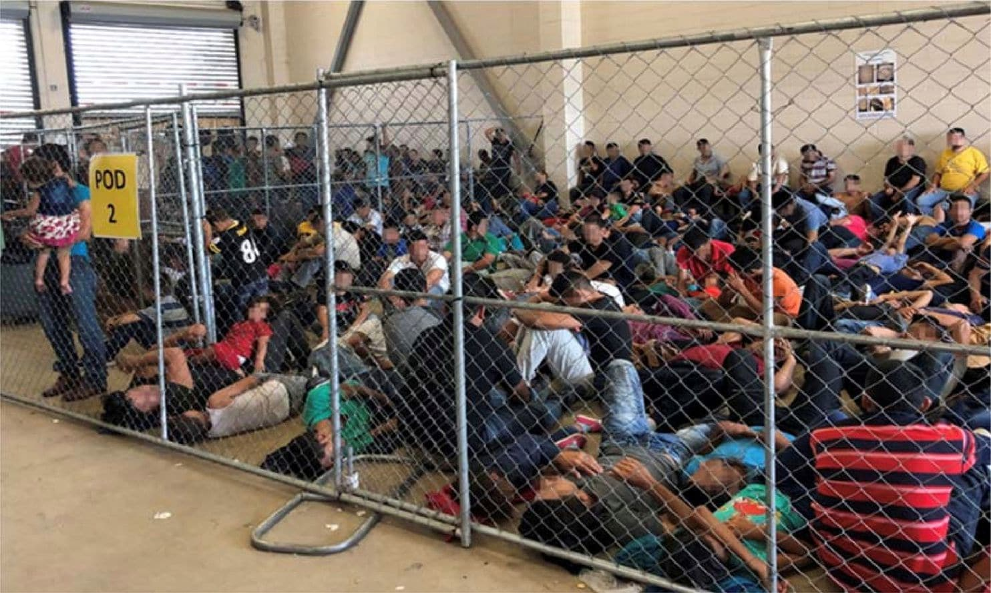
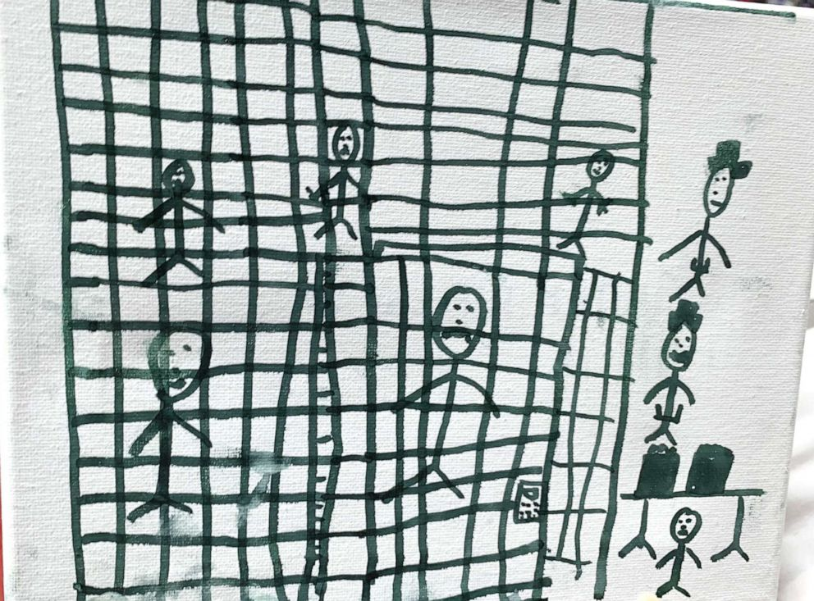
Impact on Students and Families
From 1994 to 2017, the population of immigrant children in the United States grew by 51 %
Undocumented status
Mixed status
Separation of families
Reunification after separation
Detention centers
Racism and xenophobia
Stereotypes
Notes:
"Why don't "illegals" get in the back of the line, and do it the right way?" The short answer is that "the line" is a mythical place, a phrase used to deflect the need for immigration reform. The fact is, for most undocumented immigrants there is no application they can fill out, process they can go through, not even a fine they can pay to start the process of becoming U.S. citizens. As a former undocumented immigrant, I know firsthand that being undocumented is not a state one chooses. The first challenge to immigrating to the U.S. legally is that there are only a few categories to obtain a worker visa to legally work in the U.S., including for fashion models of "distinguished merit and ability
The second challenge undocumented immigrants face in becoming permanent residents, and eventually U.S. Citizens is that there are only a handful of ways to obtain permanent residency; through family, a job (which as explained above is not feasible for many immigrants), as asylum seekers, and a few other special circumstances. Unless an undocumented immigrant has a relative, such as a mother, father, or spouse that is a permanent resident or U.S. Citizen, there are few other processes to fix their immigration status.
From 1994 to 2017, the population of immigrant children in the United States grew by 51 percent, to 19.6 million, or one-quarter of all U.S. children. The majority of immigrant children are second generation, while first-generation immigrants make up a smaller population (16.7 million and 2.9 million, respectively).
In 2017, a higher percentage of first-generation immigrant children (those born outside the United States) lived below the federal poverty line (25 percent) than second-generation children (those born inside the United States) and non-immigrant children (those who are not first- or second-generation immigrants) (22 and 17 percent, respectively).
The proportion of first-generation immigrant children born in Mexico decreased from 37 percent in 2006 to 18 percent in 2017, a record low; in 2017, the next three most common birthplaces for first-generation immigrant children were India (8 percent), China (5 percent), and the Philippines (3 percent).
Undocumented status affects more than 1 million children today, which is about one-third of all immigrant youth. Another 4.5 million U.S.-born youth have an undocumented parent. Children face barriers because of their parents’ undocumented status, often related to poverty, fears of deportation, and more, while undocumented youth themselves face increasing barriers to social mobility as they enter adolescence and hope to obtain driver’s licenses, afterschool work, and financial aid for college. Even when children themselves are unaware of their family members’ legal status, being undocumented or the child of an undocumented parent negatively impacts a child’s development.

Slide 12
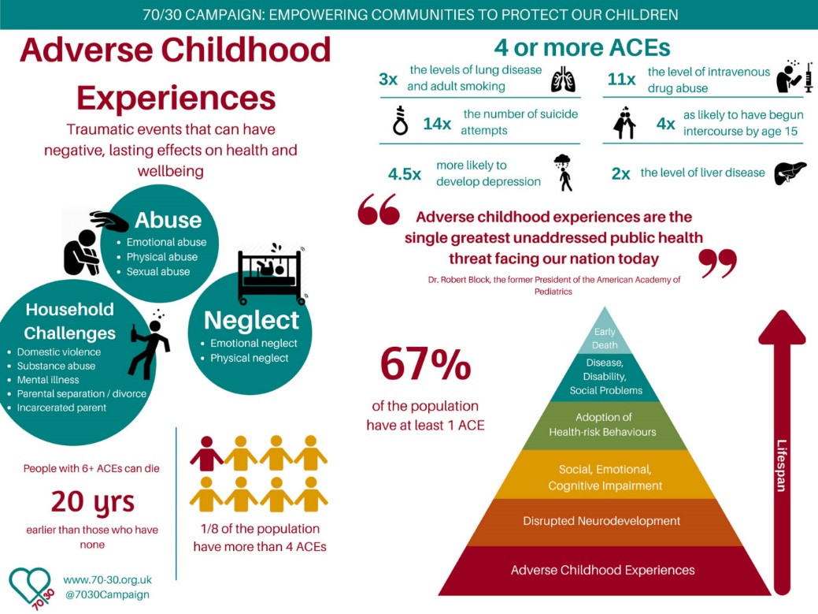
Continued impact
Basic needs
Extreme trauma
Gaps in education
Assimilation
Grief and Loss
Missing paperwork
Health issues
Fear
Notes:
Separating children from their parents or caregivers hurts children. Between April 19 and May 31, nearly 2,000 children were separated from their parents. As Celeste Fremon reported in WitnessLa, that number has now passed 2,300 children (and is increasing by more than 60/day), with another 11,000 locked up in everything from large cages to a converted Walmart.
“To pretend that separated children do not grow up with the shrapnel of this traumatic experience embedded in their minds is to disregard everything we know about child development, the brain, and trauma,” says a petition signed by more than 9,000 mentalhealth professionals and 172 organizations.
Fears include: deportation, reporting crimes to the police, exploitation, applying for public assistance etc.
Language differences- children speaking English and parents speaking Spanish
Mixed status- some have citizenship some do not
Grief and loss of family, culture, country, a life left behind

Slide 13
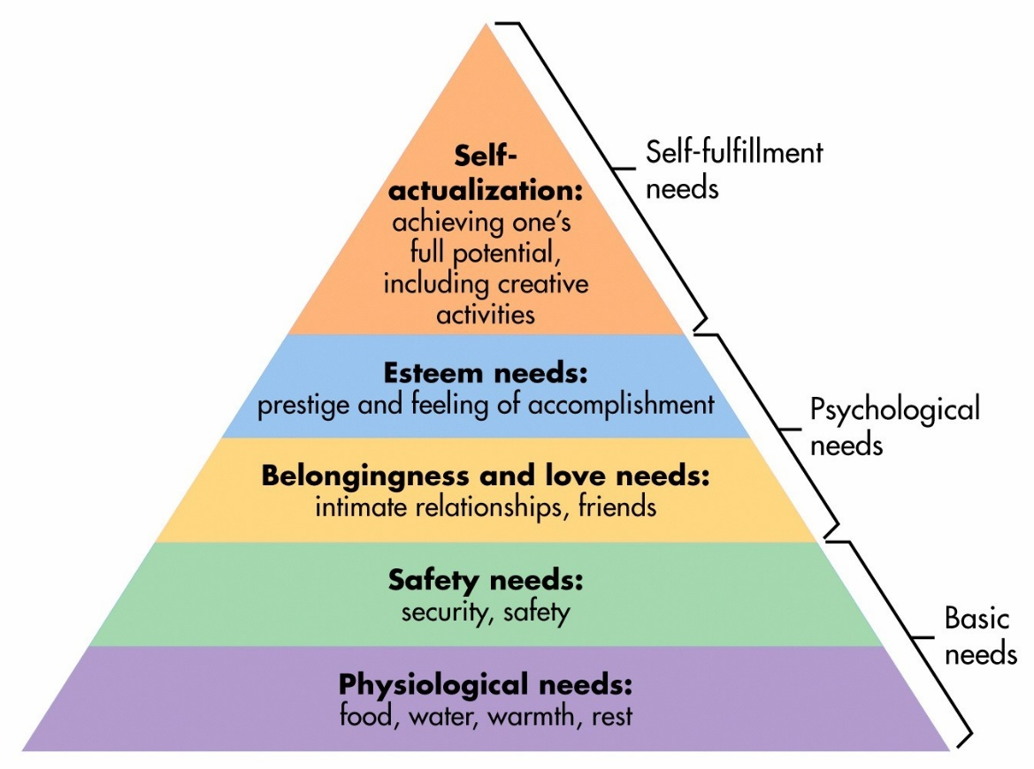
What we can do to help
Trauma-informed
Assist with basic needs
Create safe-spaces
Provide resources
Cultural humility

Slide 14
Trauma- Informed Schools
Essential Elements of a Trauma-Informed School System
Identifying and assessing traumatic stress.
Addressing and treating traumatic stress.
Teaching trauma education and awareness.
Having partnerships with students and families.
Creating a trauma-informed learning environment (social/emotional skills and wellness).
Being culturally responsive.
Integrating emergency management & crisis response.
Understanding and addressing staff self-care and secondary traumatic stress.
Evaluating and revising school discipline policies and practices.
Collaborating across systems and establishing community partnerships.

Slide 15
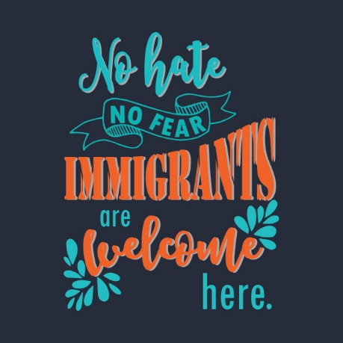

Slide 16
Resources
Houston immigration Legal Services Collaborative (HILSC)
Hotline
www.Needhou.org
Resource list Developed by Legacy Social Workers
Basic Needs
Important information and resources

Slide 17
“Remember: Everyone in the classroom has a story that leads to misbehavior or defiance. Nine times out of ten, the story behind the misbehavior won’t make you angry. It will break your heart.”
-Annette Breaux

Slide 18
Questions?
Contact information:
ebowen@legacycommunityhealth.org

